Slide 1
Please view this presentation in “Slide Show” mode, it contains fancy animations.
Team Yellow Old Dominion University 9/23/2020
Load.In Feasibility Presentation 1

Slide 2
Load.in
Give your move a game plan.
Team Yellow
Feasibility Presentation
Old Dominion University
9/23/2020

Slide 3
Contents
Team Biography: 4-7
The Problem: 8-16
Problem Statement: 9
Problem Characteristics: 11-16
Current Process Flow: 17-19
Major Functional Component Diagram: 20-21
Competition: 22-23
References:
Glossary

Slide 4
Who is Team Yellow?

Slide 5
Byron Aquilino
Lance Perdue
Gregory Kukanich

Slide 6
Jason Moran
Daniel Reyna
Chris Miller

Slide 7
Paul Rodriguez

Slide 8
What problem are we trying to solve?

Slide 9
78.3% of Americans move without the assistance of professional movers. Those Americans must navigate logistical uncertainties.

Slide 10
Golly, moving day is a real stinker!!!

Slide 11
What are the characteristics of the problem?

Slide 12
78.3% of Americans go without the help of professional movers.

Slide 13
Determining how big of a truck to get and how many trips a move will take is difficult to do accurately.

Slide 14
Loading a truck properly requires many considerations including weight distribution and protecting fragile items.

Slide 15
Poor packing can result in property damage. In the worst case, a car accident.

Slide 16
35% of Americans are stressed the most by logistics and packing.

Slide 17
What is the current process?

Slide 18
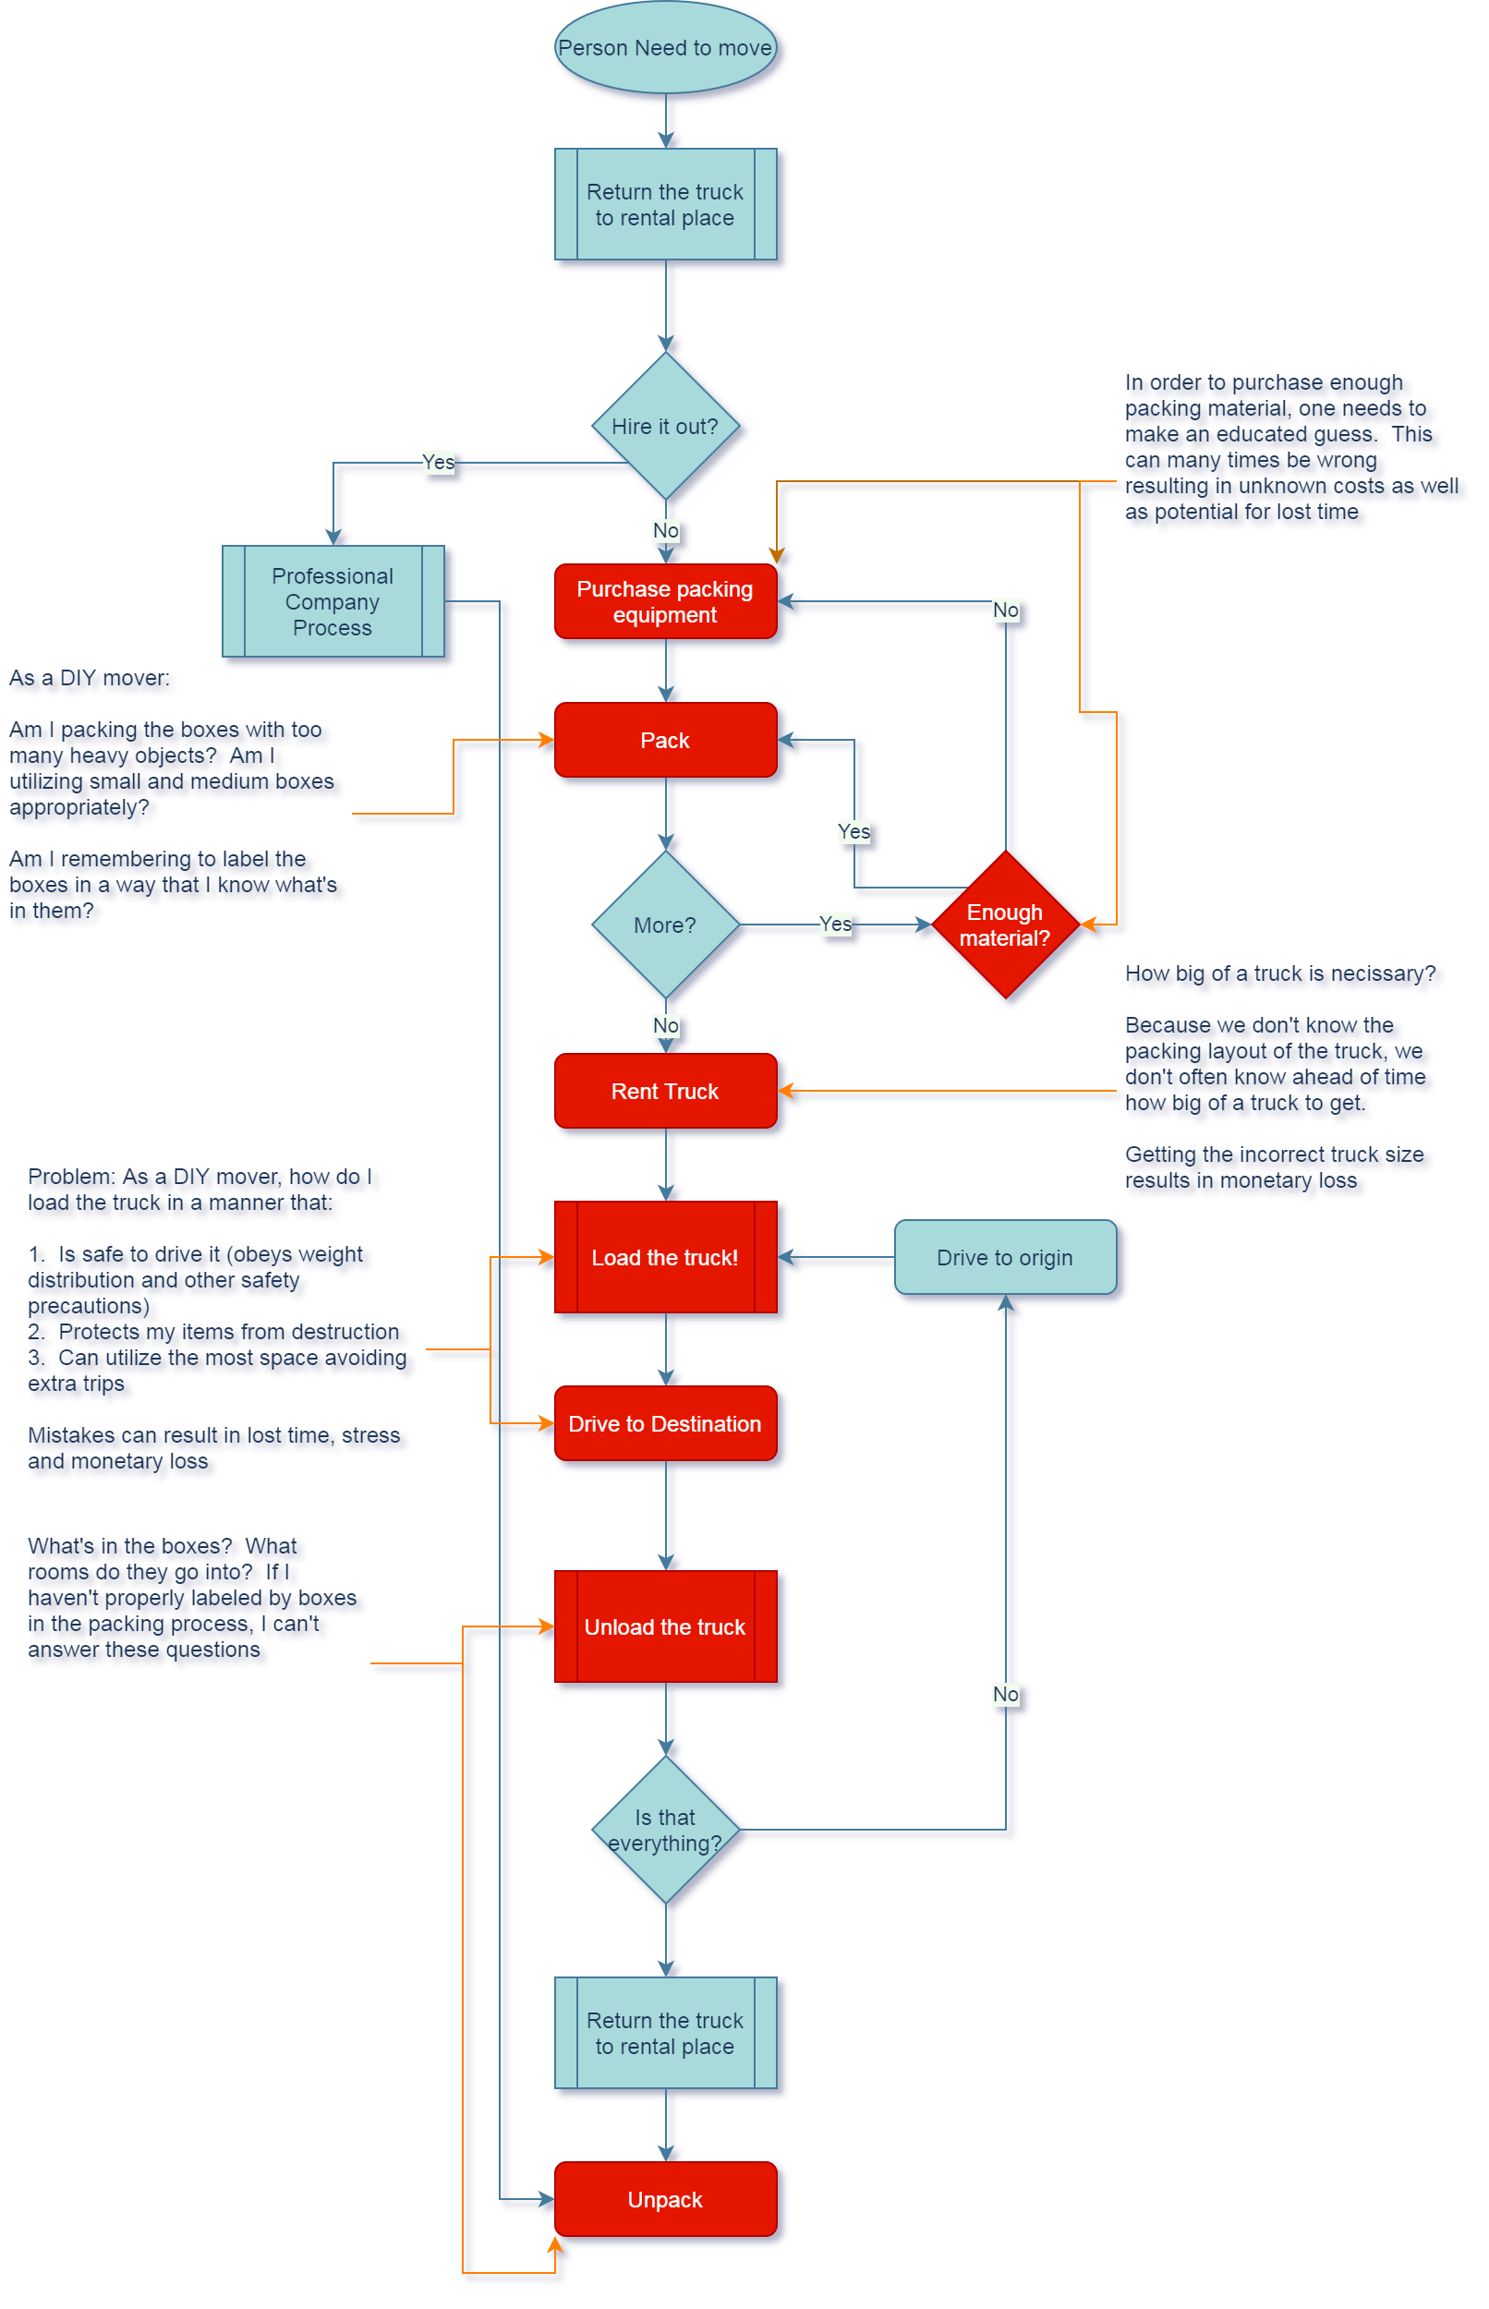

Slide 20
What are the major functional components?

Slide 21
ADD THE MAJOR FUNCTIONAL COMPONENTS DRAFT HERE, CHRIS!!!

Slide 22
What’s the competition like?

Slide 23
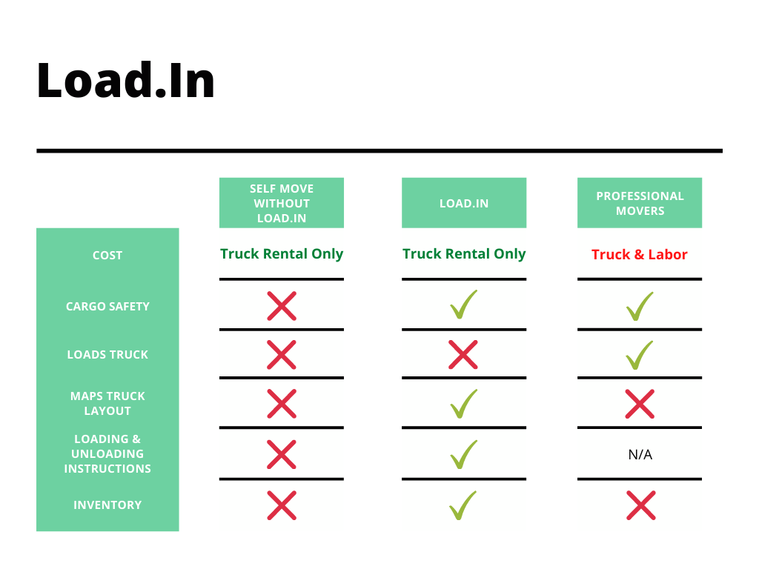

Slide 25
Sources:
The Top 5 Moving Mistakes Across America. (2019, August 13). Article. https://www.article.com/blog/top-5-moving-mistakes/
Economy Moving & Storage, LLC. (2015, January 4). How to properly pack and load a moving truck- Movers Cincinnati. YouTube. https://www.youtube.com/watch?v=rjmofUZOdwo&feature=youtu.be
CADCode Systems. (n.d.). Optimizing & Machining | CADCode Systems. CADCode.Com. Retrieved September 20, 2020, from https://www.cadcode.com/category/categories/optimizing-machining
Dube, E. (2020, September 20). OPTIMIZING THREE-DIMENSIONAL BIN PACKING THROUGH SIMULATION. Semantics Scholar. https://www.semanticscholar.org/paper/OPTIMIZING-THREE-DIMENSIONAL-BIN-PACKING-THROUGH-Dube/bb9986af2f26f7726fcef1bc684eac8239c9b853#references
Knoblauch, M. (2019, May 8). One in ten Americans would prefer a week in jail over moving. New York Post. https://nypost.com/2019/05/08/one-in-ten-americans-would-prefer-a-week-in-jail-over-moving/
The American Institute of Stress. (n.d.). The Holmes-Rahe Stress Inventory PDF. Retrieved September 20, 2020, from https://www.stress.org/wp-content/uploads/2019/04/stress-inventory-1.pdf
Wood, T. (2020, January 6). Moving Industry Statistics. MoveBuddha. https://www.movebuddha.com/blog/moving-industry-statistics/
Nat and Friends. (2017, April 18). Google Earth’s Incredible 3D Imagery, Explained. YouTube. https://www.youtube.com/watch?v=suo_aUTUpps&feature=youtu.be
Collins, T. (2018, April 20). A Look Into Photogrammetry and Video Games - Tiger Collins. Medium. https://medium.com/@homicidalnacho/a-look-into-photogrammetry-and-video-games-71d602f51c31

